Slide 1

WELCOME TO OUR CLASS
Unit 2 – My Home
Lesson 5 – Skills 1
Teacher: Đỗ Thị Thanh Vân
Class: 6A1

Slide 2

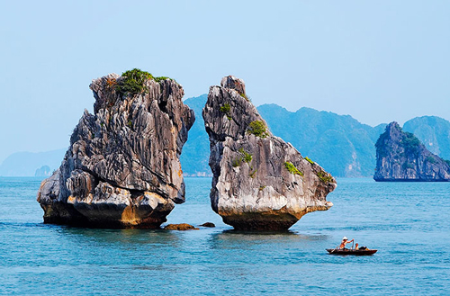
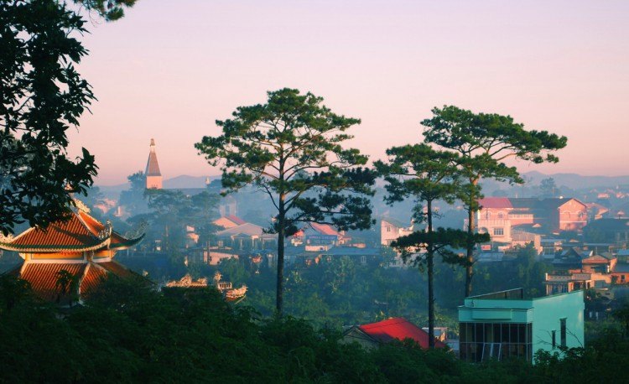
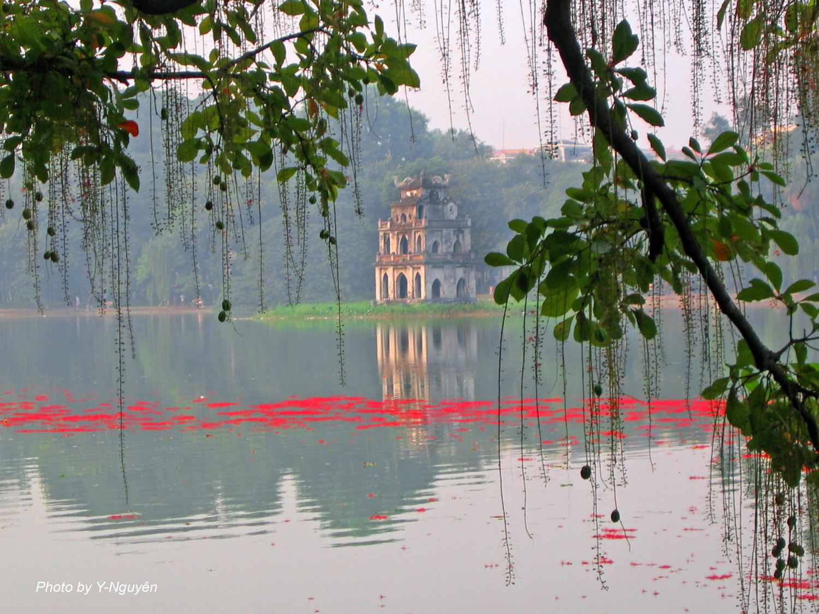
Guessing game: Which places are they?
1. The first place:
There are many places of interest here
We can enjoy some special food in this place such as: pho, bun cha
It’s the heart of our country.
2. The second place:
It’s in the north of Vietnam.
It has a World Heritage.
There are many mountains in the sea.
3. The third place:
This place has 4 seasons in a day.
It’s a famous for many flowers.
It has Valley of Love, Waterfalls.

Slide 3
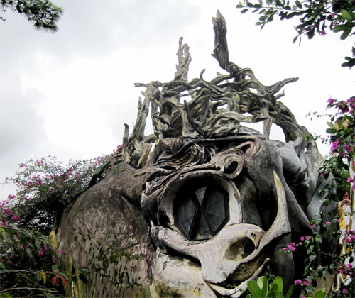
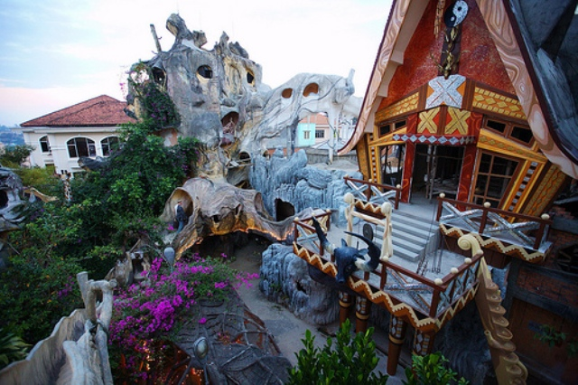
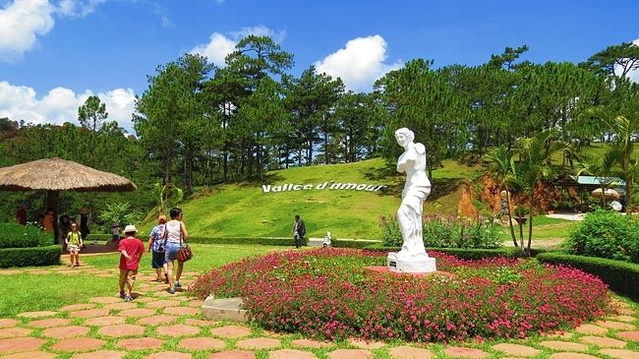

Slide 4

Look at the text ( don’t read it ). Answer the questions.
1. What type of text is it ?
2. What’s the title of this page? What’s the topic?
3. Write three things you know about Da Lat .

Slide 5
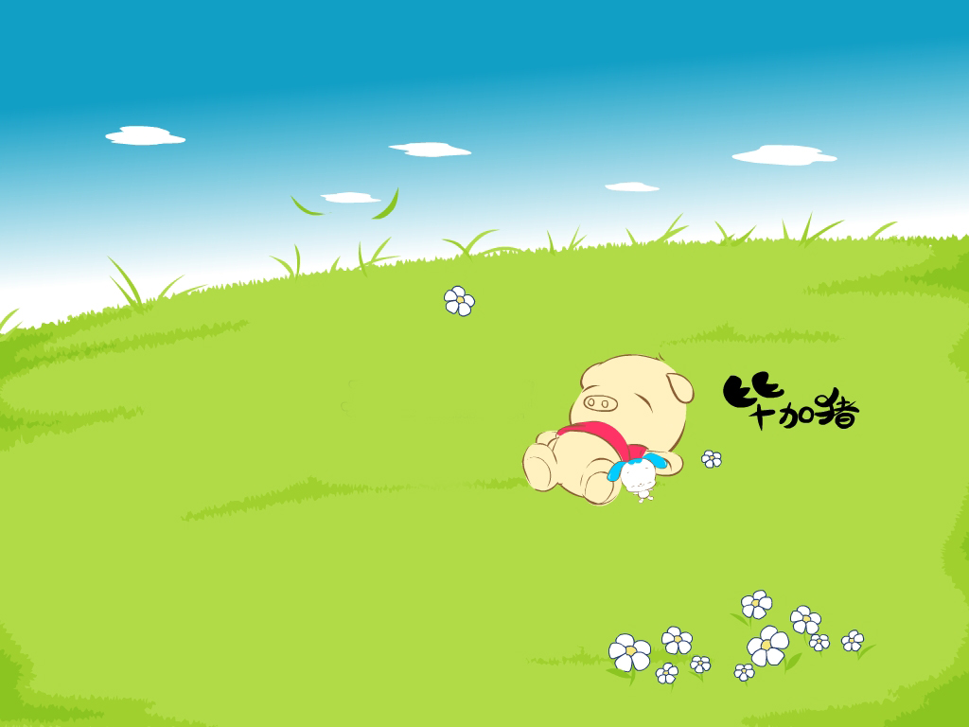
Reading
To : mi@fastmail.com ; superphong@bamboo.com
Subject : Weekend away !
Hi Phong and Mi,
How are you ? I’m Da Lat with my parents . We are staying at the Crazy House Hotel . Wow! It really is crazy .
Da Lat is nice . It’s cool all year round! There are a lot of things to see and lots of tourists too.
There are ten rooms in the hotel . They are named after different animals. There is
a Kangaroo room , an Eagle room, and even an Ant Room . I’m staying in the Tiger room . It’s called the Tiger room because there’s a big tiger on the wall.
The tiger is between the bathroom door and the window . The bed is under the window – but the window is a strange shape . I put my bag under the bed . I put my books on the shelf . There is a lamp , a wardrobe and a desk . There are clothes on the floor – it’s messy , just like my bedroom at home.
You should visit here , it’s great.
See you soon!
Nick

Slide 6
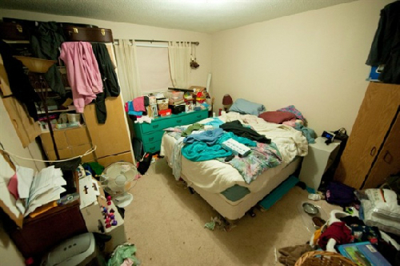
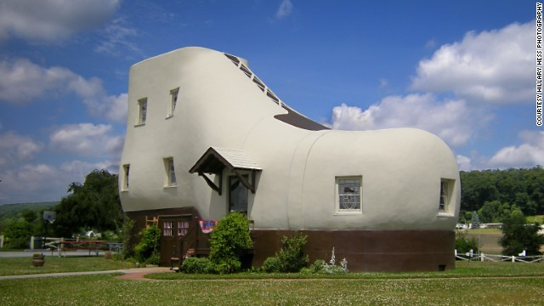
I, New words
messy (adj) :
Bừa bộn
crazy (adj) :
Cuồng nhiệt, say mê
shape (n) :
Hình dạng
strange (adj) :
Kì lạ

Slide 7
Reading
To : mi@fastmail.com ; superphong@bamboo.com
Subject : Weekend away !
Hi Phong and Mi,
How are you ? I’m Da Lat with my parents . We are staying at the Crazy House Hotel . Wow! It really is crazy .
Da Lat is nice . It’s cool all year round! There are a lot of things to see and lots of tourists too.
There are ten rooms in the hotel . They are named after different animals. There is
a Kangaroo room , an Eagle room, and even an Ant Room . I’m staying in the Tiger room . It’s called the Tiger room because there’s a big tiger on the wall.
The tiger is between the bathroom door and the window . The bed is under the window – but the window is a strange shape . I put my bag under the bed . I put my books on the shelf . There is a lamp , a wardrobe and a desk . There are clothes on the floor – it’s messy , just like my bedroom at home.
You should visit here , it’s great.
See you soon!
Nick

Slide 8

Game
Is Nick with his brother and sister ?
What is the weather like in Da Lat ?
How many rooms are there in the hotel?
Why is the room called the Tiger room?
Where is his bag?

Slide 9
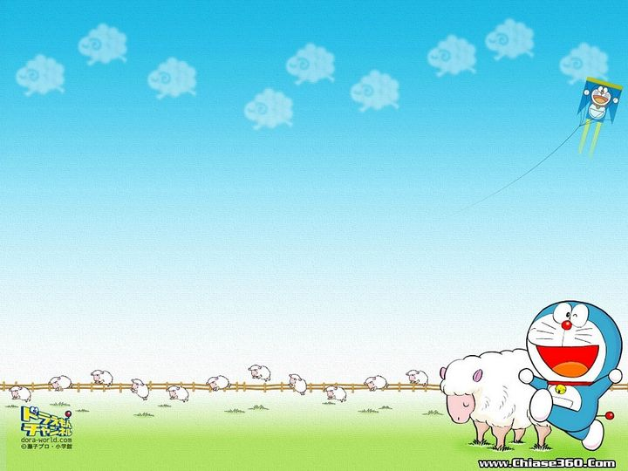
Are there things in the room?
a window
a sofa
a cooker
a cupboard
a shelf
a lamp
a desk
a poster
a CD player
a tiger

Slide 10


Learn new words by heart.
Prepare the next lesson: Skills 2

